Slide 1
LAB 4 - GOING DEEPER INTO CONVOLUTIONAL NEURAL NETWORKS
Dr. Pandiyaraju V
Shravan Venkatraman
August 9, 2024

Slide 2
TABLE OF CONTENTS
01
INTRODUCTION
01
INTRODUCTION
02
MLP RECAP
02
MLP RECAP
03
MINI BATCH GRADIENT DESCENT
03
MINI BATCH GRADIENT DESCENT
04
HYPERPARAMETER TUNING
04
HYPERPARAMETER TUNING
05
TUNING TECHNIQUES
05
TUNING TECHNIQUES

Slide 3
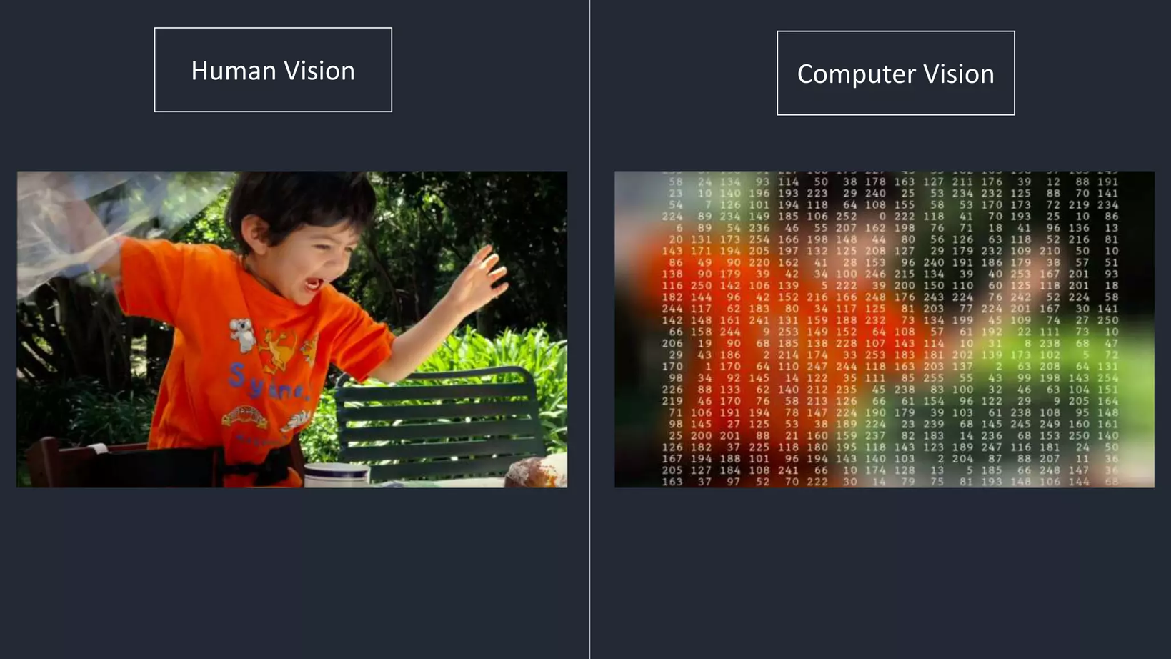
CNN RECAP

Slide 4
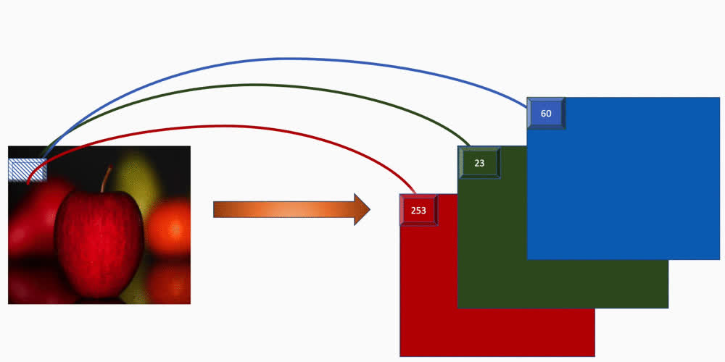
RGB IMAGE

Slide 5




PADDING AND STRIDES
Blue maps are inputs, and cyan maps are outputs.
https://github.com/vdumoulin/conv_arithmetic
No Padding
1 Stride
Same Padding
1 Stride
1 Padding
2 Strides
2 Padding
1 Stride

Slide 6
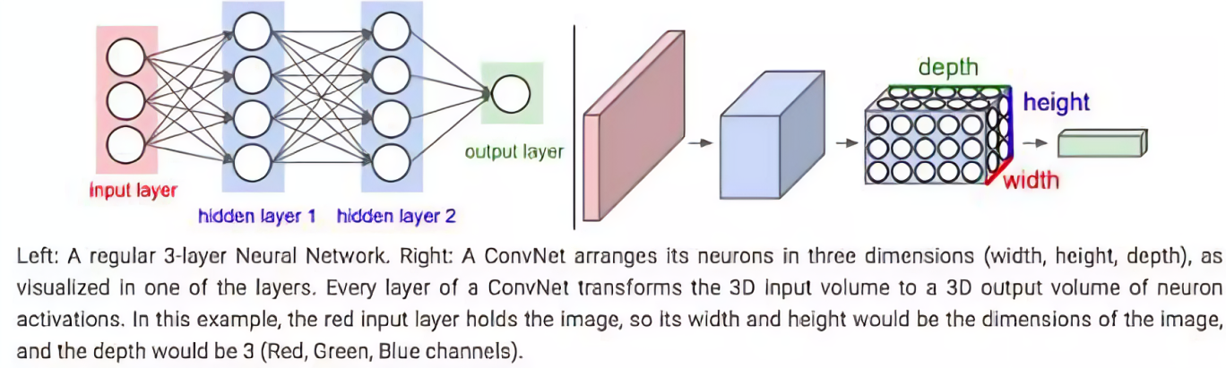
WHY CNNS?

Slide 7
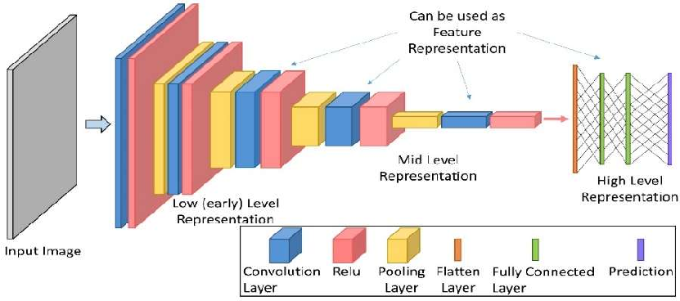
COMPONENTS OF A CNN
Hidden Layers / Feature Extraction Part: the part where feature extraction happens, via a series of convolutions and pooling operations.
The classification part: the fully connected layers will serve as the classifier on top of these extracted features.

Slide 8
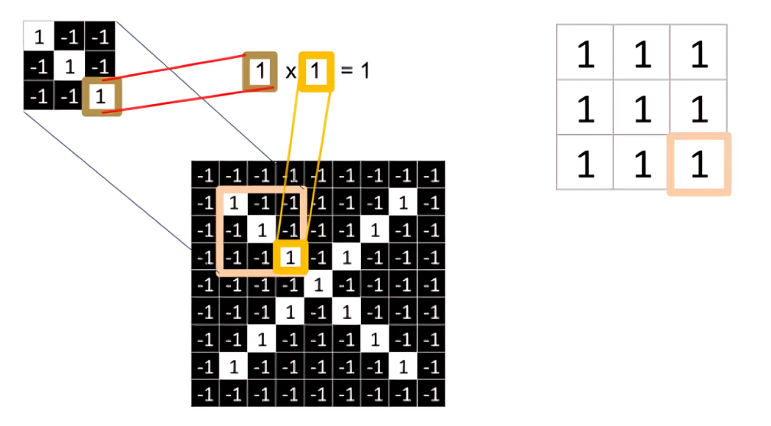
WHAT HAPPENS WHEN YOU DO A CONVOLUTION?

Slide 9
WHAT HAPPENS WHEN YOU DO A CONVOLUTION?

Slide 10
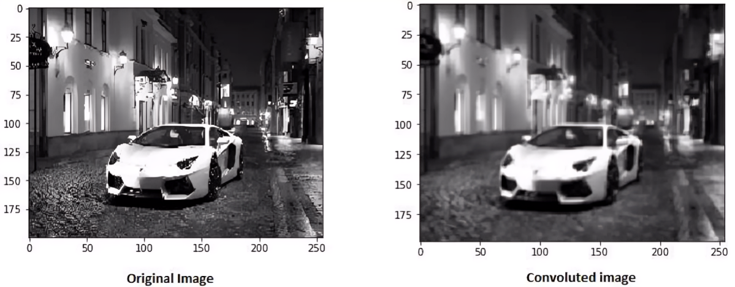
WHAT HAPPENS WHEN YOU DO A CONVOLUTION?

Slide 11
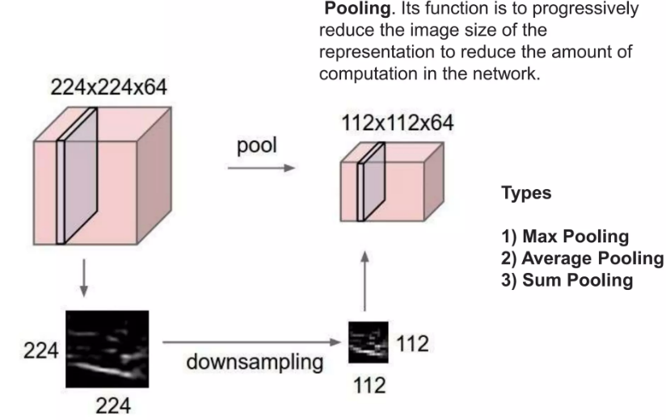
WHAT HAPPENS WHEN YOU MAXPOOL?

Slide 12
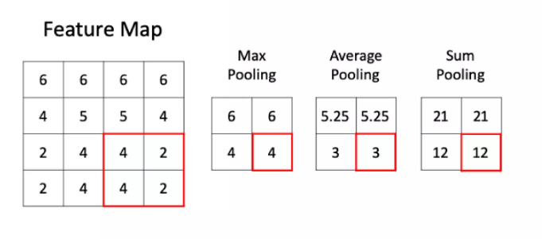
WHAT HAPPENS WHEN YOU MAXPOOL?

Slide 13
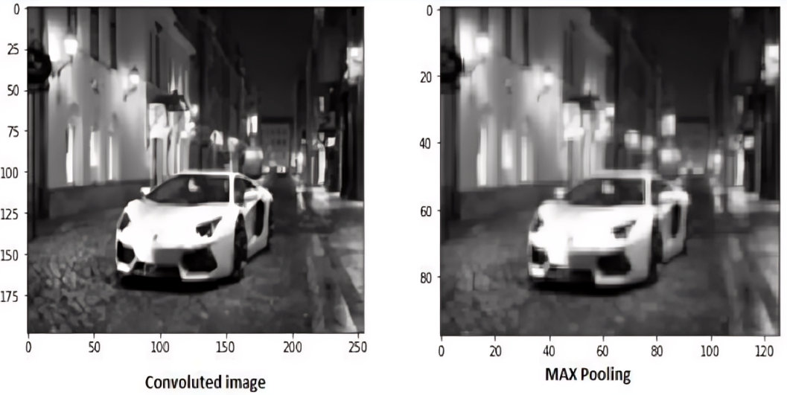
WHAT HAPPENS WHEN YOU MAXPOOL?

Slide 14

WAYS TO CONVERT FEATURE MAP TO 1D

Slide 15
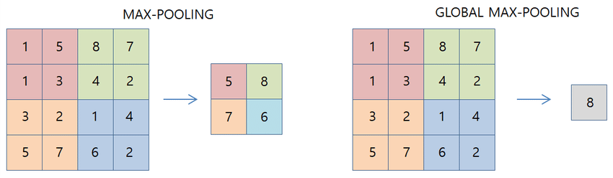
WAYS TO CONVERT FEATURE MAP TO 1D

Slide 16
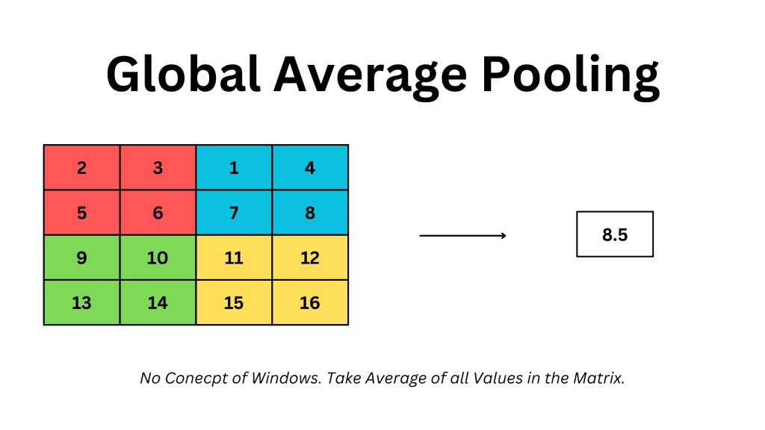
WAYS TO CONVERT FEATURE MAP TO 1D

Slide 17
WHERE ARE CNNS PRIMARILY USED
Image Classification (Disease Detection, Face Recognition, etc.)
Object Detection (Spot Lesions from Medical Images, Potholes from live surveillance cameras, etc.)
Semantic Segmentation (Tumor Segmentation from Medical Images)
Instance Segmentation (Segment individual objects in crowded scenes, Identify Overlapping Nuclei, etc.)
Image Generation (GANs, Style Transfer, etc.)

Slide 18
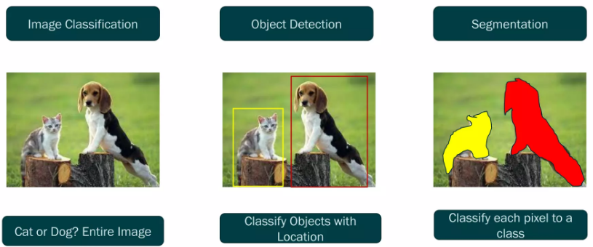
WHERE ARE CNNS PRIMARILY USED

Slide 19
BUILDING COMPLEX MODELS - KERAS FUNCTIONAL API

Slide 20
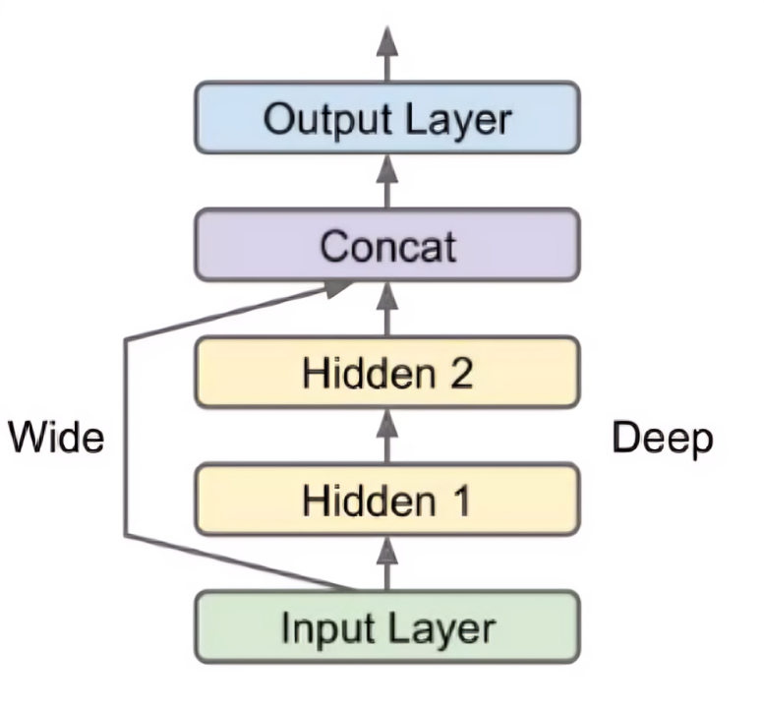
FUNCTIONAL API
The functional API is a way to create models that are more flexible than the Sequential API (tf.keras.Sequential)
It can handle models with non-linear topology, models with shared layers, and models with multiple inputs or outputs.
Enables us to build neural networks to learn both deep patterns (using the deep path) and simple rules (through the short path).

Slide 21
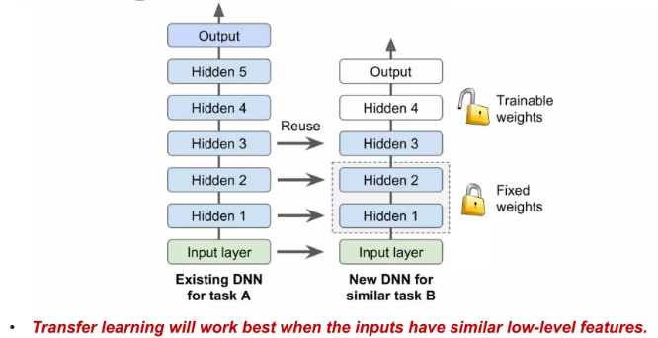
TRANSFER LEARNING

Slide 22
LOW-LEVEL AND HIGH-LEVEL FEATURES
Low-Level Features
These features are typically extracted by the early layers of a CNN and include:
Edges
Textures
Basic Geometric Shapes
High-Level Features
These features are extracted by deeper layers of the CNN and represent more complex patterns or objects:
Object Parts (eyes, nose)
Complex Patterns (combination of certain features)

Slide 23
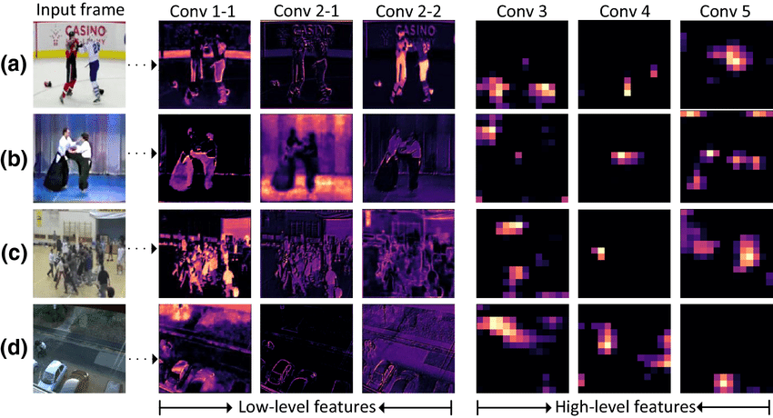
LOW-LEVEL AND HIGH-LEVEL FEATURES

Slide 24
TRANSFER LEARNING MODELS
When To Use Which Model? (not a rule of thumb, but its good to know the reason behind why each model was designed) | When To Use Which Model? (not a rule of thumb, but its good to know the reason behind why each model was designed) | When To Use Which Model? (not a rule of thumb, but its good to know the reason behind why each model was designed)
Xception | Suitable for high-resolution image datasets where the model needs to handle a large number of parameters efficiently while capturing complex features. | Suitable for high-resolution image datasets where the model needs to handle a large number of parameters efficiently while capturing complex features.
Inception | Ideal when depth perception is crucial, such as when understanding the distance between the lens and the object. | Ideal when depth perception is crucial, such as when understanding the distance between the lens and the object.
VGG | Effective when fine-grained details are important and where computational resources are less of a concern due to its deeper architecture and large number of parameters. | Effective when fine-grained details are important and where computational resources are less of a concern due to its deeper architecture and large number of parameters.

Slide 25
TRANSFER LEARNING MODELS
When To Use Which Model? (not a rule of thumb, but its good to know the reason behind why each model was designed) | When To Use Which Model? (not a rule of thumb, but its good to know the reason behind why each model was designed) | When To Use Which Model? (not a rule of thumb, but its good to know the reason behind why each model was designed)
ResNet | Beneficial for tasks where vanishing gradients are an issue: ResNet - residual connections that help gradients flow through the network. DenseNet - each layer's output is concatenated with the outputs of all preceding layers. | Beneficial for tasks where vanishing gradients are an issue: ResNet - residual connections that help gradients flow through the network. DenseNet - each layer's output is concatenated with the outputs of all preceding layers.
DenseNet | Beneficial for tasks where vanishing gradients are an issue: ResNet - residual connections that help gradients flow through the network. DenseNet - each layer's output is concatenated with the outputs of all preceding layers. | Beneficial for tasks where vanishing gradients are an issue: ResNet - residual connections that help gradients flow through the network. DenseNet - each layer's output is concatenated with the outputs of all preceding layers.
EfficientNet | Optimal for scenarios where computational efficiency and accuracy need to be balanced. | Optimal for scenarios where computational efficiency and accuracy need to be balanced.
MobileNet | Optimal for scenarios where computational efficiency and accuracy need to be balanced. | Optimal for scenarios where computational efficiency and accuracy need to be balanced.
You can find the list of all the available transfer learning models under the TensorFlow Applications website: https://www.tensorflow.org/api_docs/python/tf/keras/applications

Slide 26
DATA AUGMENTATION
Enhance model robustness and generalization by artificially expanding the training dataset.
Benefits:
Increase Dataset Size
Prevent Overfitting
Improve Model Performance

Slide 27
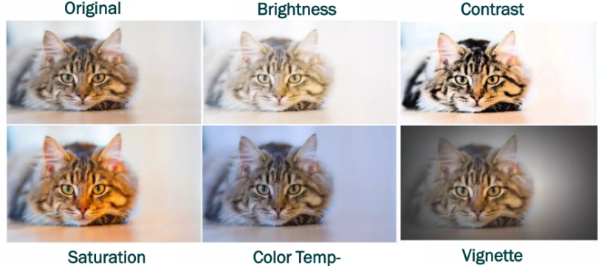
HOW IS IT DONE?
Color and Illumination Examples

Slide 28
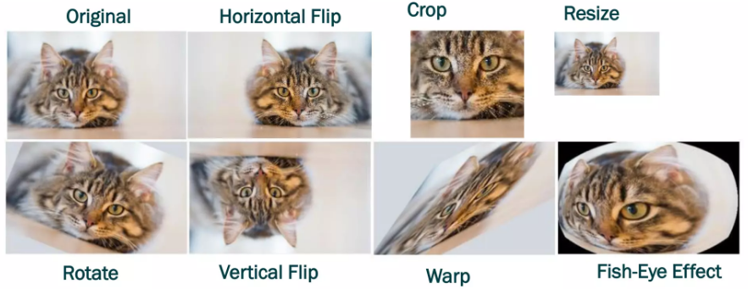
HOW IS IT DONE?
Geometric and Displacement Distortion Examples

Slide 29
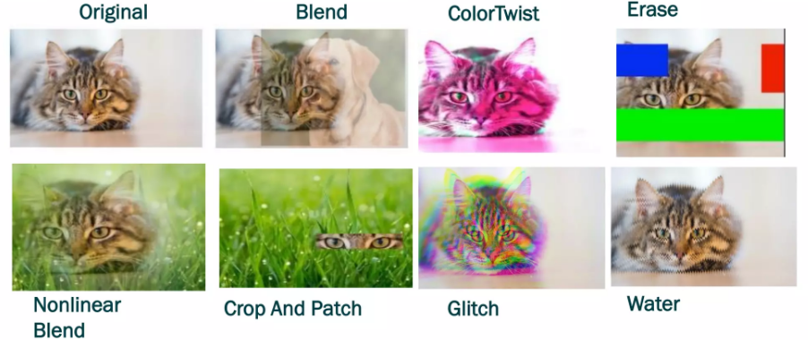
HOW IS IT DONE?
Mixing Augmentations - Disruptive

Slide 30
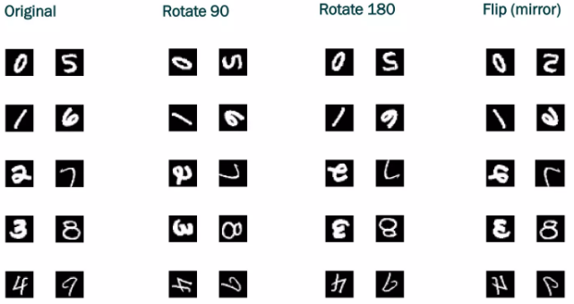
WHEN SHOULD YOU USE WHICH AUGMENTATION TECHNIQUE?
Not all augmentations apply to all datasets!

Slide 31
HANDS ON
Face Recognition using CNNs: https://colab.research.google.com/drive/1YbOcNwU1IzLLaDA2z1cgdu-sitrzBGj8?usp=sharing
Ensembling using CNNs: https://colab.research.google.com/drive/1mjUmNeoPJuibVc5z_Wr5rHLKNUIi0QaS?usp=sharing

Slide 32
CHALLENGE TASK
Task 1: Image Classification with CIFAR-10 Dataset
Train two artificial neural networks (ANNs) on the CIFAR-10 dataset using mini-batch gradient descent. Apply hyperparameter tuning to both models, using different regularization techniques for each. Evaluate the model's performance with visualizations of loss and accuracy, and display with reasoning as to which model performed better.
Task 2: Predicting House Prices with the Boston Housing Dataset
Implement an artificial neural network (ANN) for regression on the Boston Housing dataset, applying minibatch gradient descent, hyperparameter tuning, and various regularization techniques. Assess the model using Mean Squared Error and visualize training progress.
Dataset link: https://www.kaggle.com/code/prasadperera/the-boston-housing-dataset
You can load the datasets via TensorFlow/Kaggle API.

Slide 33
REFERENCES
https://developer.ibm.com/articles/introduction-to-convolutional-neural-networks/
"A Comprehensive Review on Transfer Learning" by Pan, S. J., & Yang, Q. (2010).
"Deep Learning" by Ian Goodfellow, Yoshua Bengio, and Aaron Courville. Includes comprehensive coverage of CNNs.
https://www.tensorflow.org/guide/keras/functional_api
https://www.analyticsvidhya.com/blog/2021/05/convolutional-neural-networks-cnn/

